Slide 1
Smart Control Solution
to increase the independence of older adults

Slide 2
Why?
The goal of the Smart Control Solution (CSC) is to help older adults maintain the sense of independence later in life.
Independence is viewed as a crucial component to successful aging [1]
Amount of assistance by next of kin is the largest factor in seniors view themselves as independent [2]
Almost 50% of seniors need help with daily activities [3]
Lack of independence later in life is attached to the connotation of passivity, burden and undesirability [2]

Slide 3
Design of the Smart Control Solution
Consisting of 4 components:
Smart Devices: The smart devices are devices such as automated blinds and lights that can be controlled over Bluetooth.
Smart Home: The smart home allows the Smart Devices to be controlled over Wi-Fi.
Control Phone Application: The phone application is primarily used as a relay point between the Smart Home and the Smart Control (iOS only).
Smart Control: Watch Band that allows simple control over Smart Devices based on hand movement.

Slide 4
Smart Devices
This group of devices in growing, with the current devices being a Automated Blind and Smart Lights.
The creation of a new device is quick as there is a boiler plate code.
Boiler plate code includes many features such as sending data to and from peripheral and control.
Can be controlled by the phone application and Smart Control.
Types of possible devices is large, from a smart lock to smoke detector.

Slide 5


Automated Blinds
Automate the when your blinds open and close based on your desired time.
Easy to set the exact dimensions of the blinds.
A user-friendly application interface that allows the user to control the blinds.
Intuitive button commands to control the exact placement of your blinds.
Versatile design allowing the blind control to be adapted to many designs of blinds
IR remote control allows easy motion control

Slide 6
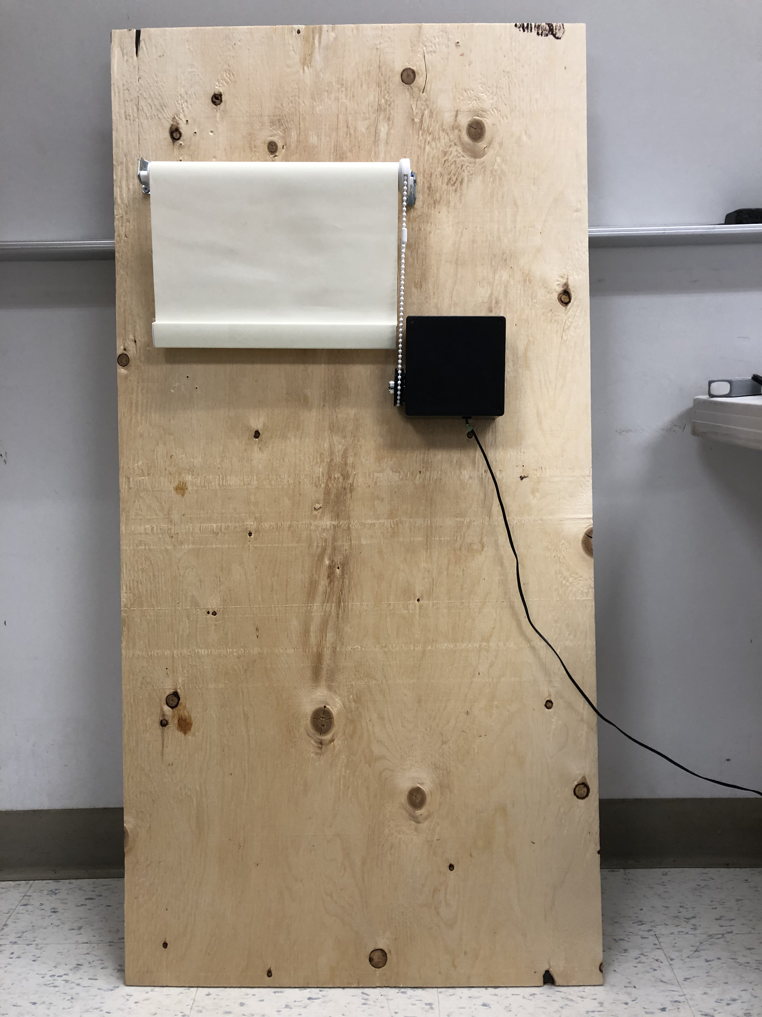
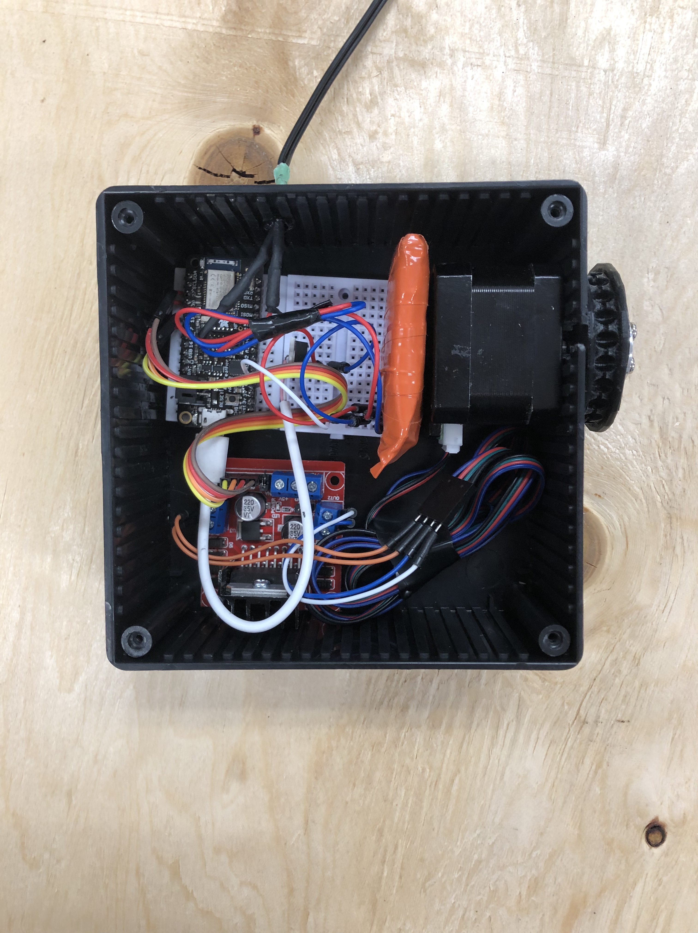
Easy Set-up
Durable Design

Slide 7
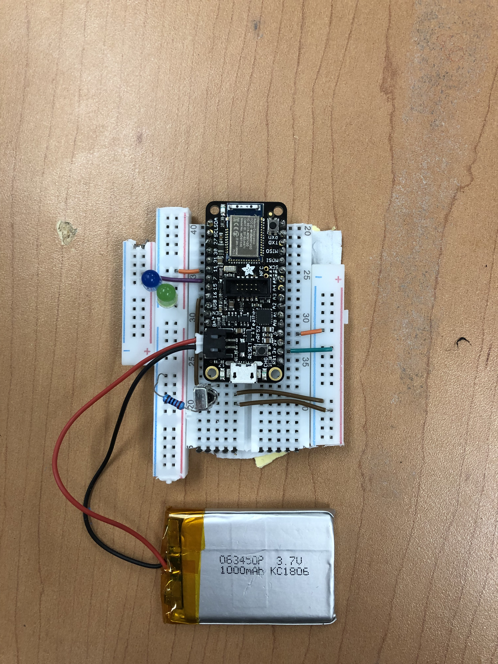
Smart Lights
IR remote control allows easy motion control
Easy to integrate into homelife.
Can be easily programmed to fit into your life with the application

Slide 8
Smart Home
Used as a relay between the Wi-Fi controls of the phone to the Bluetooth controls
Allows the user to control the smart devices from anywhere
Support for additional external Bluetooth Low Energy sensors and devices.

Slide 9
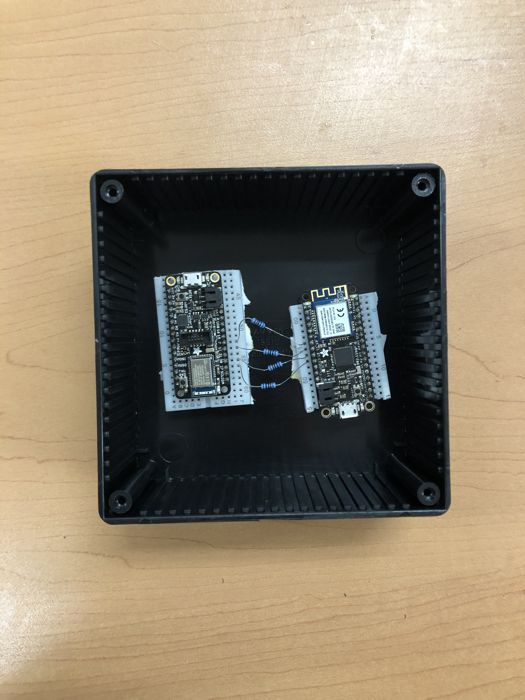
Control
Allows the user to have control over their smart devices from anywhere, with little movement and in real-time.
Simple User-Interface designed with elderly in mind.
Support for iOS operating system.
Support for additional external Bluetooth Low Energy sensors and devices.

Slide 10
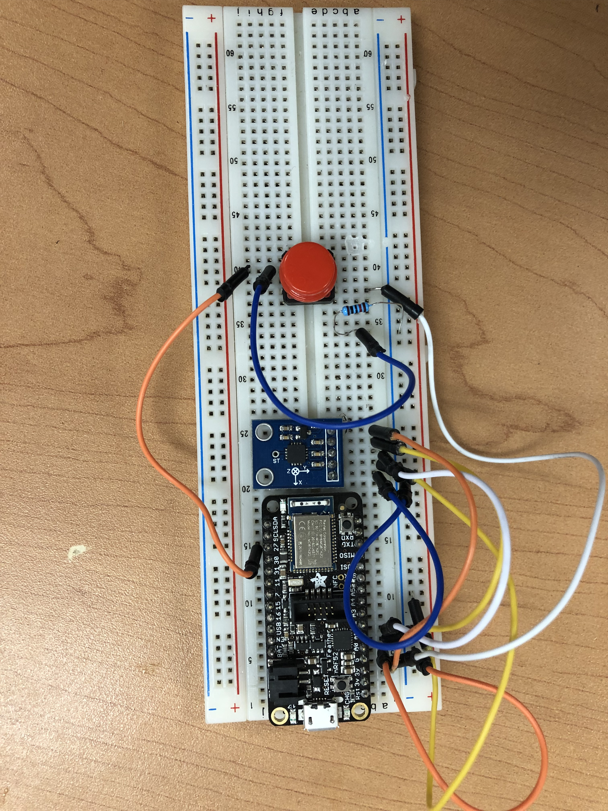
Control Band
Control Smart Devices with hand movement.
Accelerometer and gyroscope combine to allow many different movements to control different devices
Accelerometer allows speed of hand movement to control amount, e.g. speed can control the brightness of the light
Gyroscope allows orientation of the hand to change which device is activated
Control button is used to not accidentally use everyday movements to control device
IR remote control allows easy motion control

Slide 11
Bibliography
Rowe, J.W. and Kahn, R.L. (1987) Human Aging: Usual and Successful. Science, 237, 143-149. http://dx.doi.org/10.1126/science.3299702 [1]
Schwanen, T. Banister, D. and Bowling, A. (2012) Independence and mobility in later life, Geoform, Elsevier. https://www.sciencedirect.com/science/article/pii/S0016718512000784#b0320 [2]
Gleckman, H. (2014) Nearly Half of All Seniors Need Help With Daily Activities, Far More Than We Thought. Forbes, Forbes Media[3]

